Slide 1
Cloud Watch

Slide 2
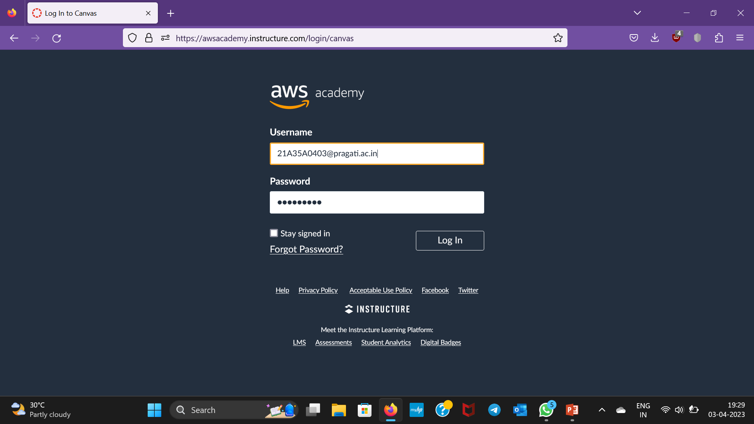
Step-1:Firstly,we have to login to the AWS accounts with username and password

Slide 3
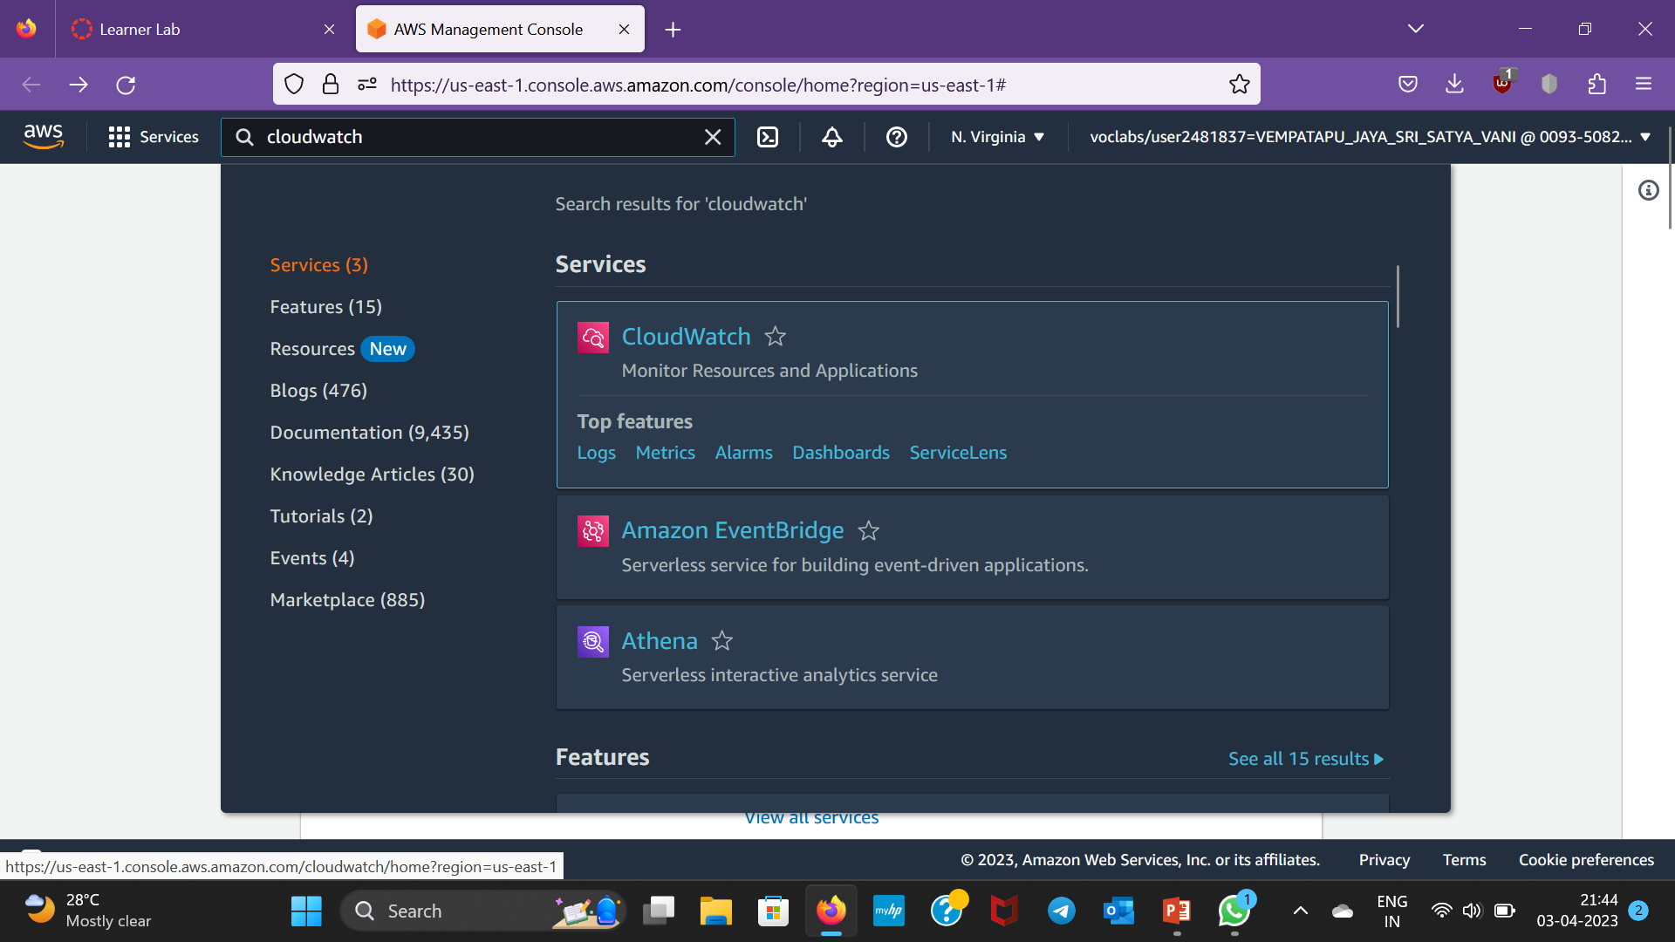
Step-2:After logging in,click on services and search for Cloudwatch and select it

Slide 4
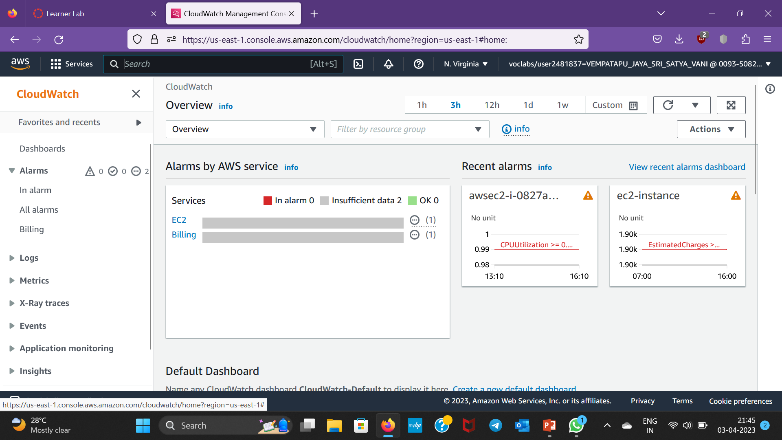
Step-3:After clicking on CloudWatch dashboard appears

Slide 5
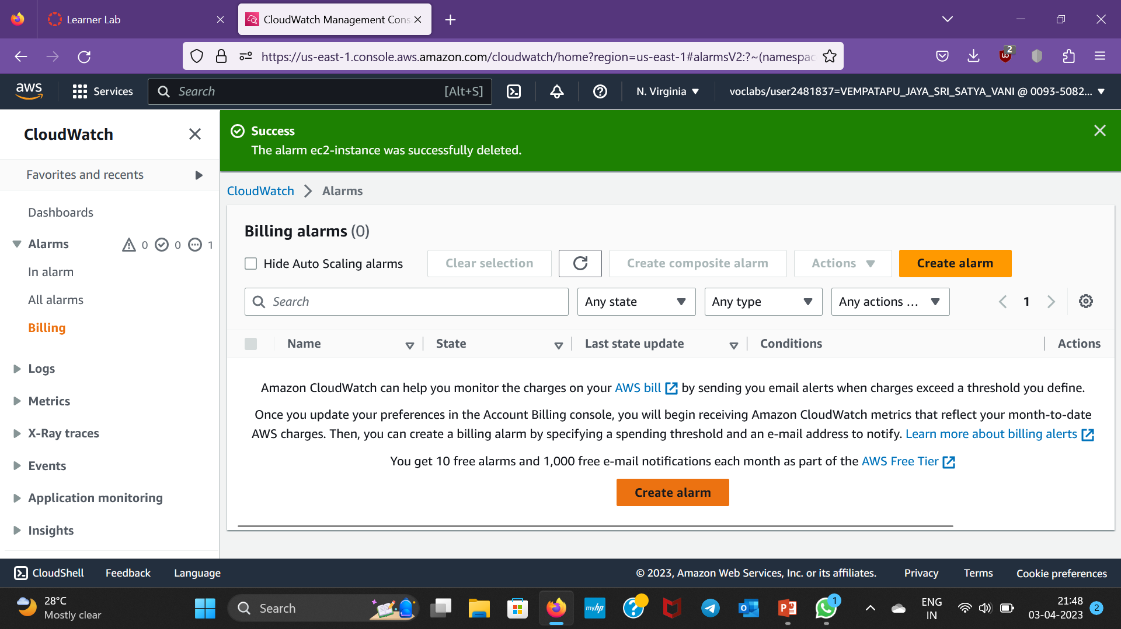
Step-4:click on Billing and then click on Create alarm downside

Slide 6
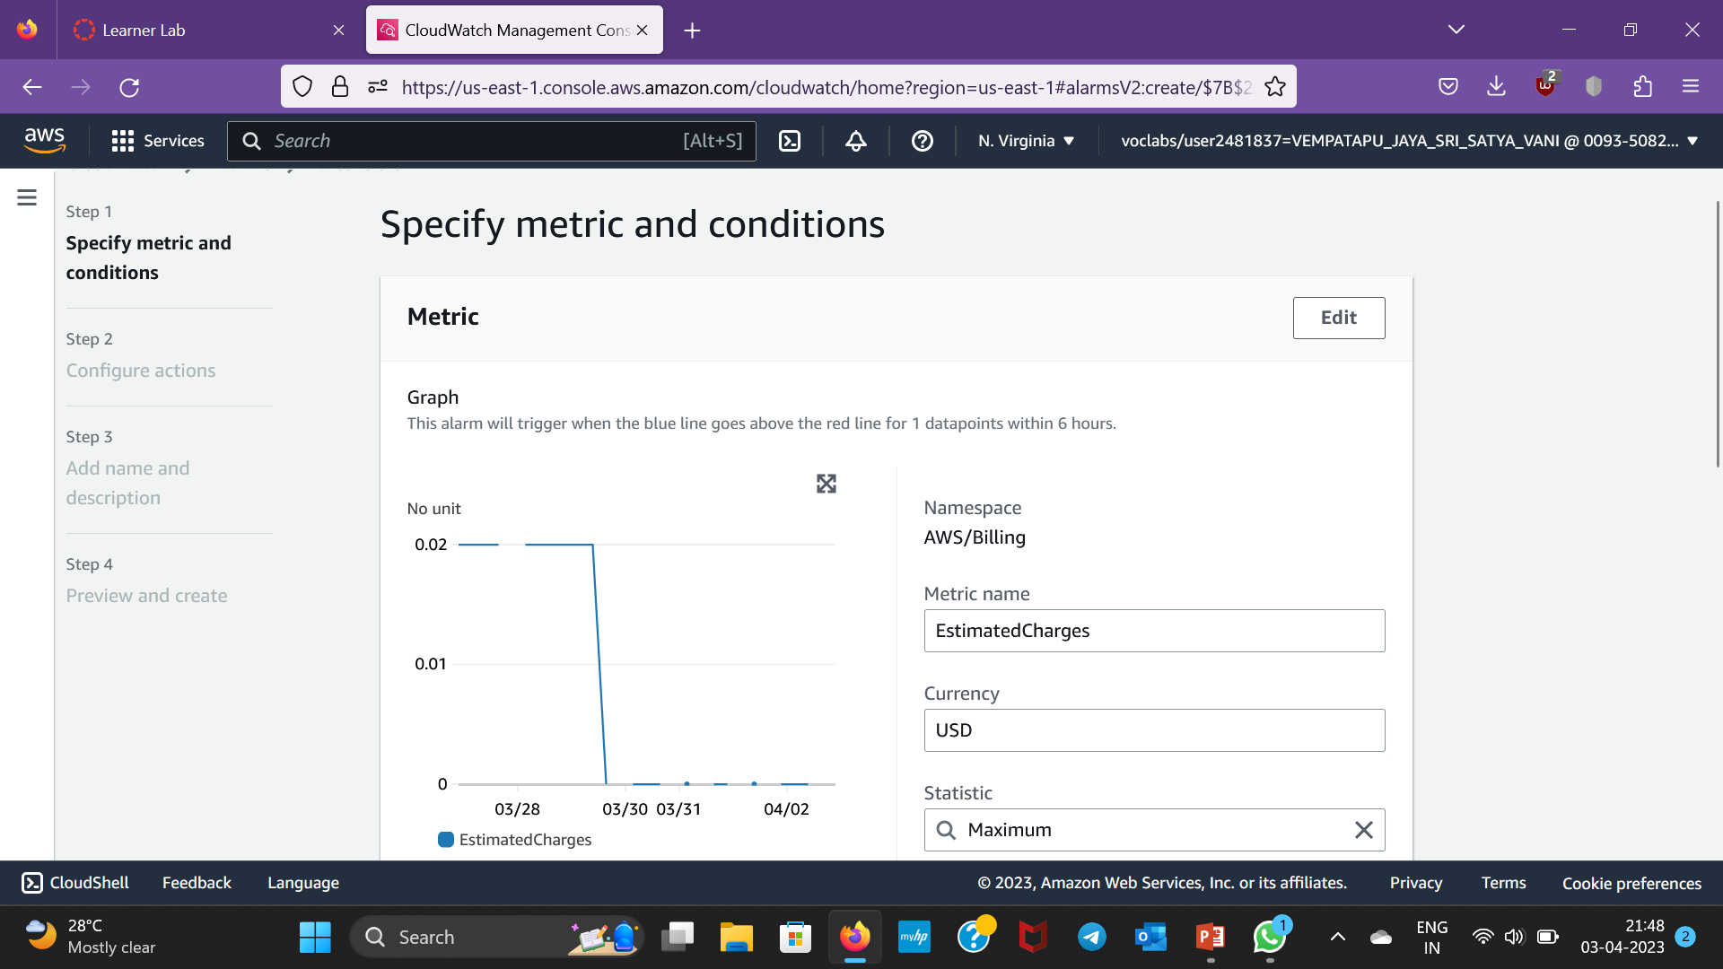
Step-5:Then a window appears as follows

Slide 7
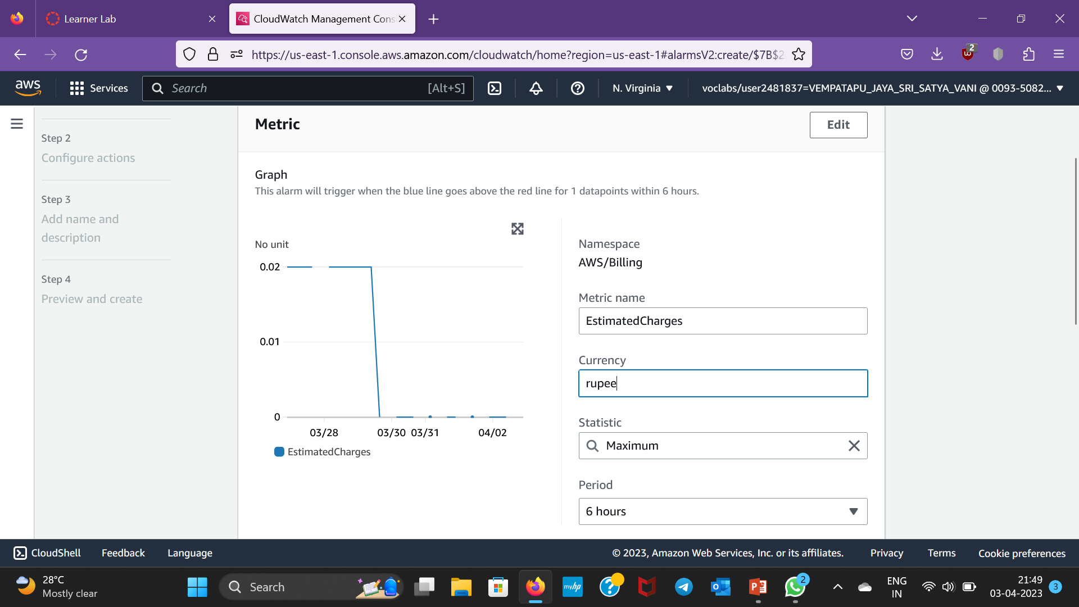
Step-6: Change the currency from USD to rupee

Slide 8
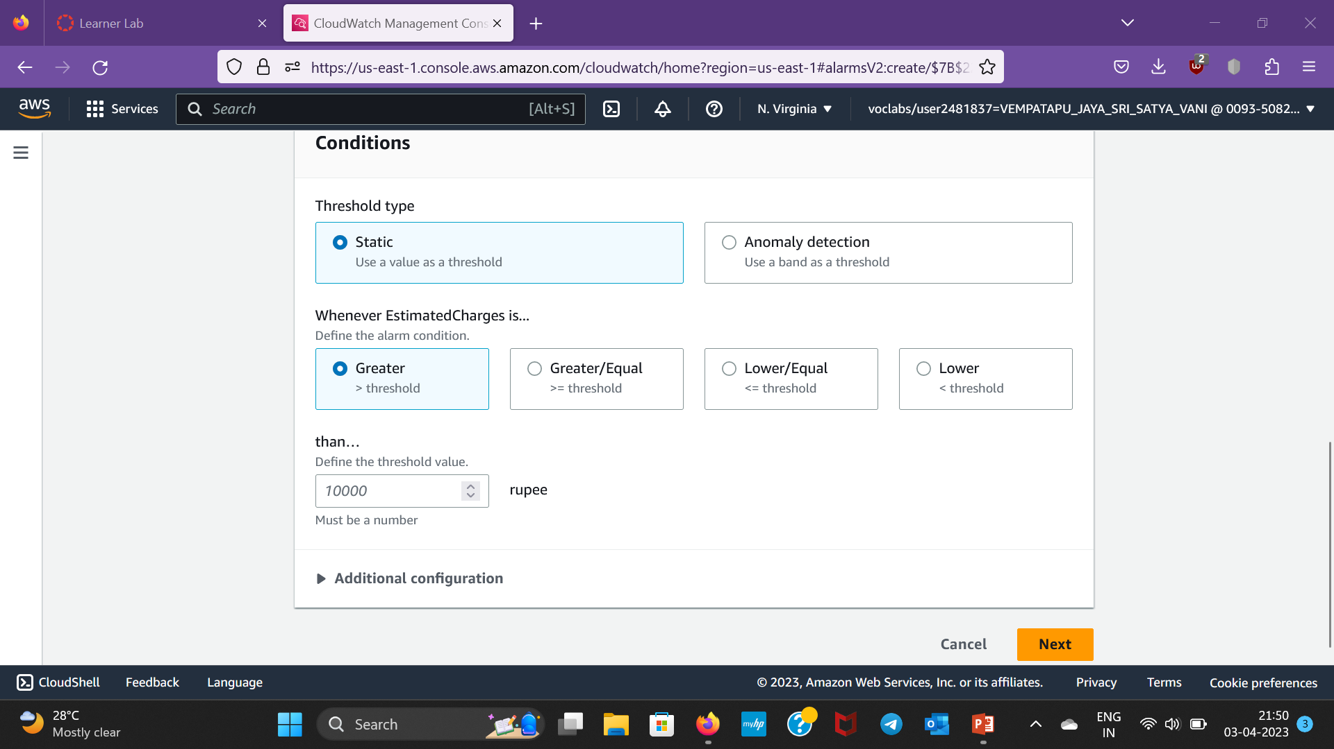
Step-7:Scroll down , give a value in threshold value and then click Next

Slide 9
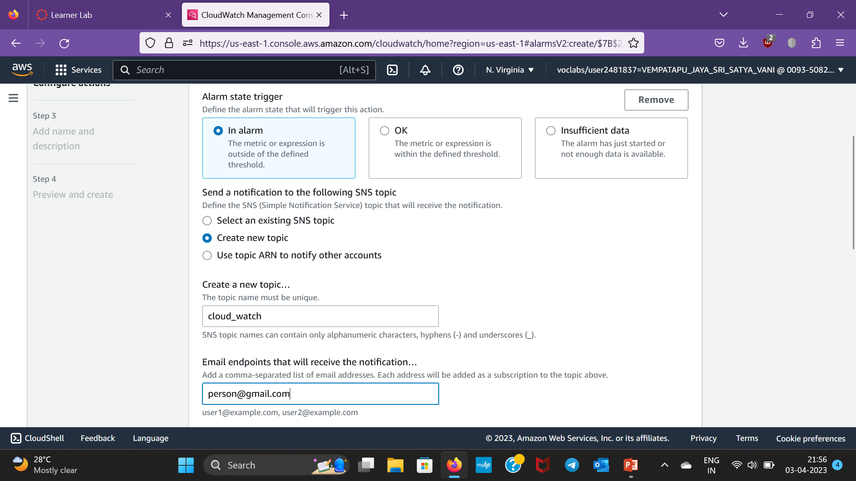
Step-8: Select Create topic and give a name and Give your email in the email list and click create topic

Slide 10
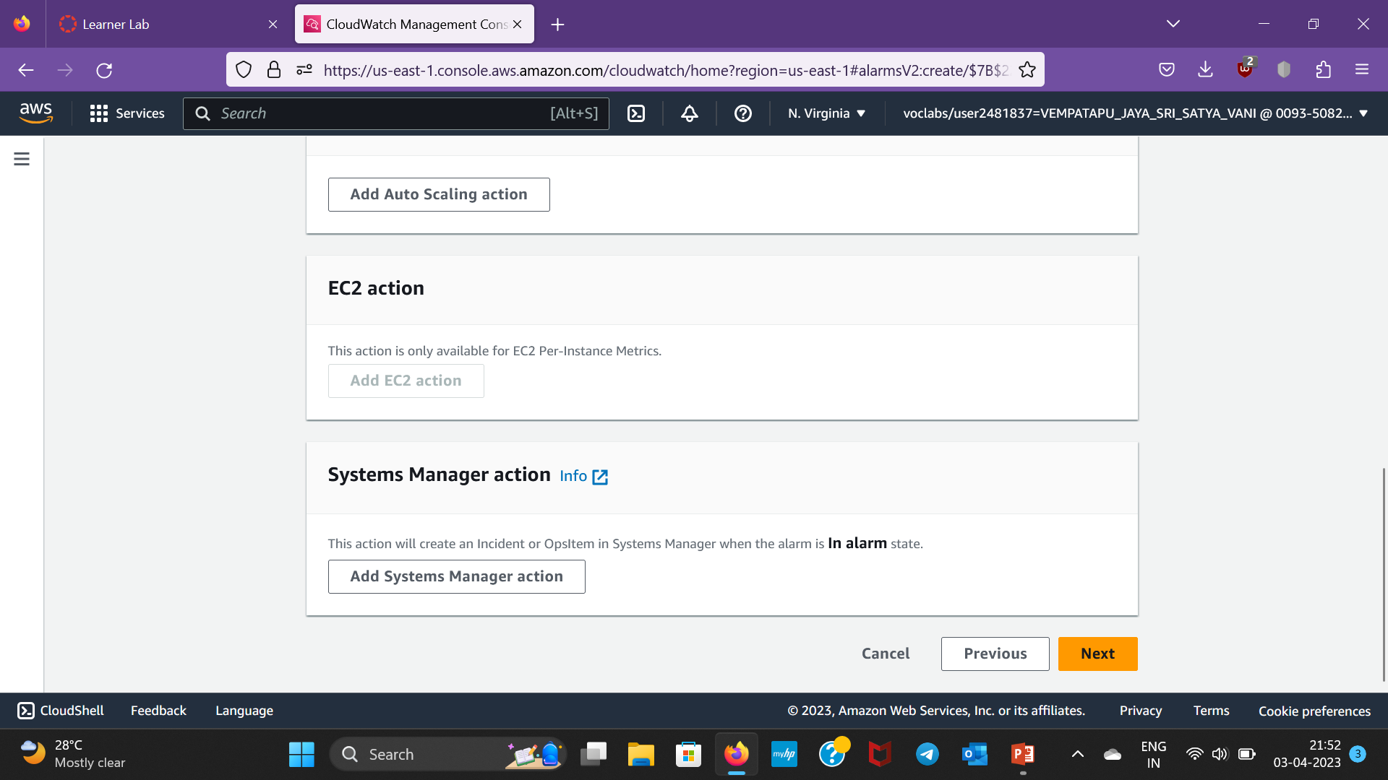
Step-9:Click Next again

Slide 11
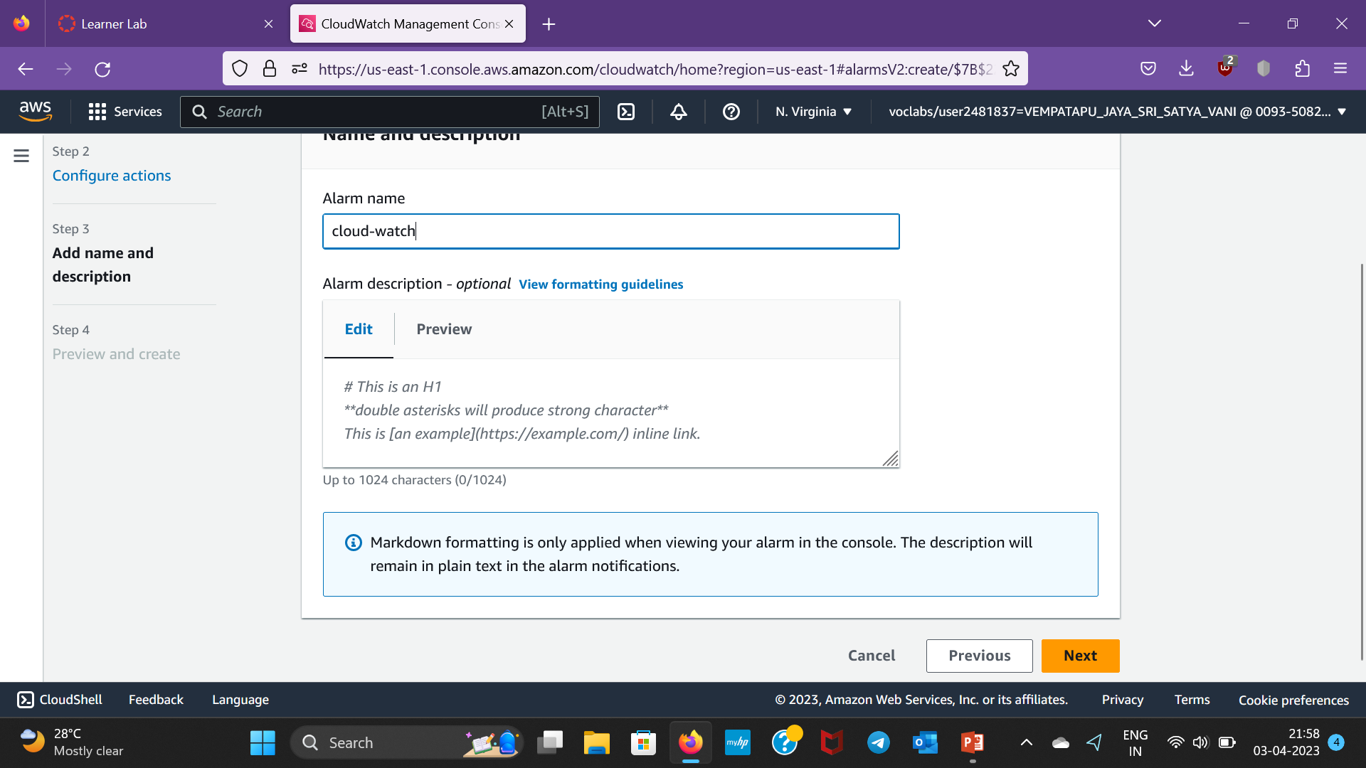
Step-10:Next,give a name to the alarm and click next

Slide 12
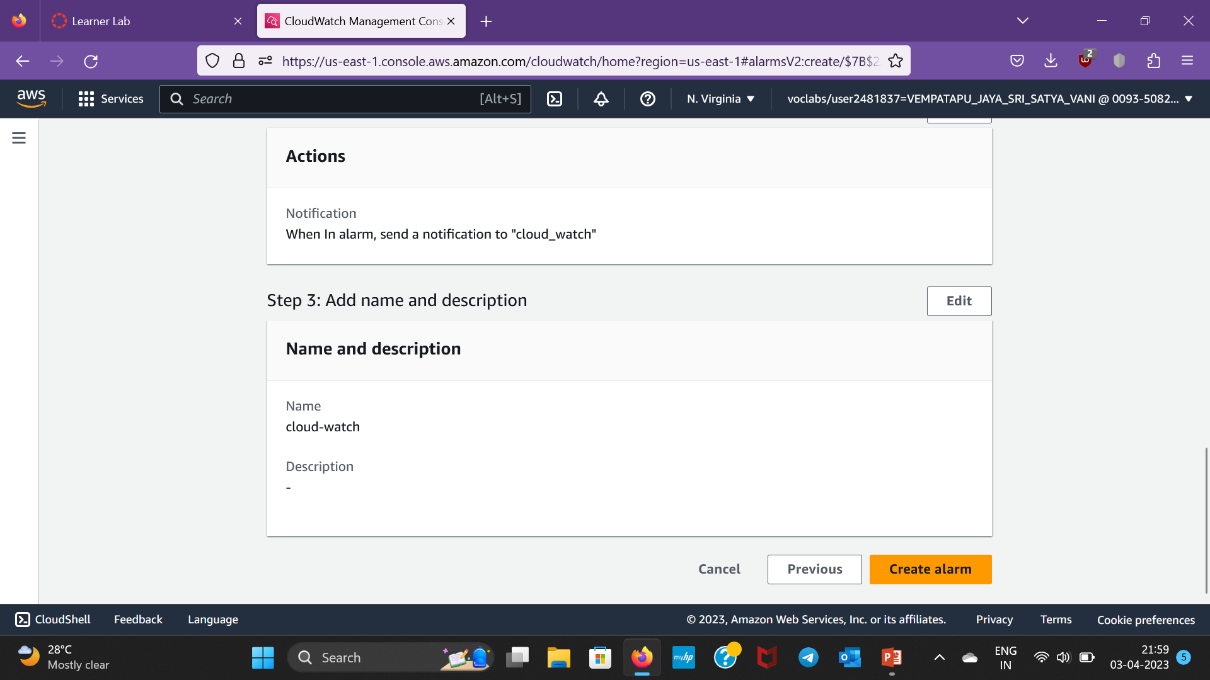
Step-11:Next,click on Create alarm

Slide 13
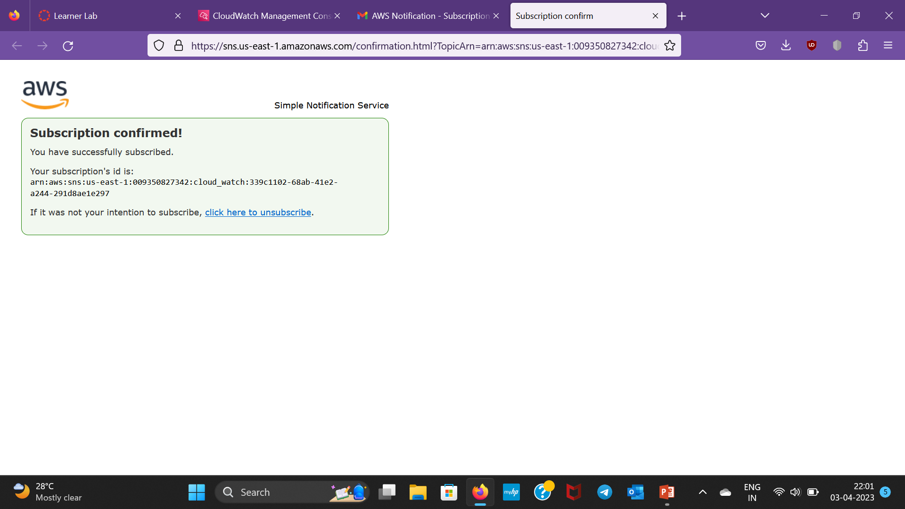
Step 12:After giving your email address, AWS will sent a notification to confirm subscription.After confirming the mail we will get like this

Slide 14
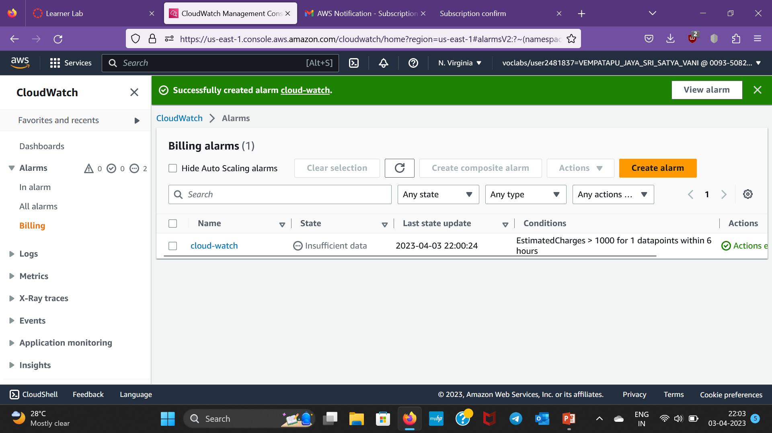
Step-13:Therefore alarm is created

